Slide 1

4.3 Unit vectors and normalization

Slide 2
Introduction
In this topic, we will
  Define a unit vector for a given norm
  Describe the algorithm for normalizing a vector
  Introduce the hat notation for finite-dimensional unit vectors

Slide 3
Norms of vectors
If , we will say that u is a unit vector if
  This depends on the norm being used
In this course, we will use the 2-norm
If a finite-dimensional vector u is known to be a unit vector,
we will put a “hat” on top of it:
  Note that this differs for other vector spaces where
  a hat meant that the expression under it describes
  the vector in question

Slide 4
Norms of vectors
If we are using the1-norm, then u is a unit vector when
If we are using the ∞-norm, the u is a unit vector when
If we are using the 2-norm, the u is a unit vector when

Slide 5

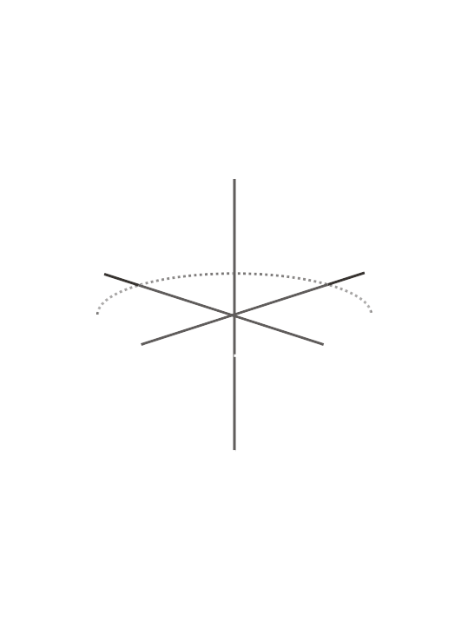
Norms of vectors
For the 2-norm:
  In R², all unit vectors lie on the unit circle
  In R³, all unit vectors lie on the surface of the unit sphere
  In R^{n}, we will say that all unit vectors
  like on the surface of the unit ball

Slide 6
Normalization of vectors
Given a non-zero vector u,
we can define its associated unit vector by defining
  Again, in general, we will almost exclusively use the 2-norm

Slide 7
Normalization of vectors
For example, given
we note ,
so normalizing u with respect to the 1-norm is

Slide 8
Normalization of vectors
For example, given
we note ,
so normalizing u with respect to the 2-norm is

Slide 9
Normalization of vectors
For example, given
we note ,
so normalizing u with respect to the ∞-norm is

Slide 10
In this course…
In general, in this course, we will be using the 2-norm
and any normalizing will be performed with respect
to this 2-norm
For example, if ,
Thus,

Slide 11
Summary
Following this topic, you now
  Understand the term unit vector
  Know that we will be generally using the 2-norm
  Understand the algorithm for converting a non-zero vector u into its associated unit vector

Slide 12
References
[1] https://en.wikipedia.org/wiki/Norm_(mathematics)
[2] https://en.wikipedia.org/wiki/Unit_vector

Slide 13
Acknowledgments
None so far.

Slide 14



Colophon
These slides were prepared using the Cambria typeface. Mathematical equations use Times New Roman, and source code is presented using Consolas.
The photographs of flowers and a monarch butter appearing on the title slide and accenting the top of each other slide were taken at the Royal Botanical Gardens in October of 2017 by Douglas Wilhelm Harder. Please see
https://www.rbg.ca/
for more information.

Slide 15
Disclaimer
These slides are provided for the ne 112 Linear algebra for nanotechnology engineering course taught at the University of Waterloo. The material in it reflects the authors’ best judgment in light of the information available to them at the time of preparation. Any reliance on these course slides by any party for any other purpose are the responsibility of such parties. The authors accept no responsibility for damages, if any, suffered by any party as a result of decisions made or actions based on these course slides for any other purpose than that for which it was intended.

